Slide 1
Presentation 2 – Hydropower Collegiate Competition
October 8th, 2024
Jennifer Edgar
Noah Dilworth
Benjamin Tushingham
Robert Quinn Ginieczki

Slide 2
Project Description
Problem Statement: Remove US reliance on coal, nuclear, and fossil fuel driven energy. Take advantage of potential energy in respect of water batteries through a closed-loop pumped storage hydropower system. This model helps address the nations clean energy goals while preserving the environment and making use of unrealized power.
Sponsor: US Department of Energy + NAU Energy Club
Advisor/Client: Dr. Carson Pete
F24toSP25_08
Robert Ginieczki
Notes:
Friendly Reminder: USE THESE

Slide 3
Black Box Model
Water
Water
Depending on other metrics affecting cost for site design (location, reservoir sizes, environmental impact) supplemental energy may be needed. The amount of supplemental energy needed will change by location.
Generate
Electricity
Electricity
Water flow rate
Figure 1: Black Box Model of a Simple Closed-Loop Pump Storage System
F24toSP25_08
Robert Ginieczki
Notes:
Main Topic: Rather than discussing the “what” of the model and how a dam works, explain how does this model help us better abstract the design problem and why did we even create it?
PRIMARY FUNCTION
ILLUSTRATES FLOWS
SPECIFIC DAMS ->DIFFERENT FUNCTIONS – ADDITIONAL IN/OUTPUTS
INFORMS FUNCTIONAL MODEL

Slide 4
Functional Model
The basic cycles involves converting between potential energy and electricity using kinetic energy as a mediary
When power is needed, water flows down the pen stock and through a turbine; and when power is in excess, water is pumped back up.
Fig. 2 - Functional Model of a simple, hydropower plant
F24toSP25_08
Noah Dilworth
Notes:
Main Topic: Rather than discussing the “what” of the model and how a dam works, explain how does this model help us better abstract the design problem and why did we even create it?
FROM CLIENT REQUIREMENTS
Helps us identify critical components for initial concept generation
STORE WATER (damn structure) – INTAKE – CONVERT TO ROT (turbine)

Slide 5
Concept Generation – Morphological Matrix
F24toSP25_08
Jennifer Edgar
Notes:
Based on the competition deliverables, we generated four concepts and put them in a morp matrix. First off, the dam structure which is designed to resist the pressure of the water in the reservoir. We chose are arch which is a good fit for tall narrow canyons, buttress, which fits wider sites and supports the dam by columns driving the pressure into ground, rockfill which is a buildup of earth materials and gravity which relies on weight for structure. Next, the water intake is the system which oversees the water flowing out of the reservoir, making sure it is done so controlled and efficiently. The ones we noticed being used most were capped intake which protects fish from going in, intake towers where debre and sediment don’t get in) , and direct flow intakes. . Third, we have the turbines, which convert the kinetic energy into mechanical energy from the flowing water for electricity generation. These are primarily, francis, which are efficient and most common), pelton good for high head, lower flow and Kaplan (which is good for varying flow rates).. . Lastly we looked at different fish passages. Juvenile bypass system is like a waterslide that is for younger fish so the are not intimidated or hurt by fast currents, a fish ladder allows fish to climb back up around a dam, Sluiceway (gradual slides down dam) and spillways with raised weir for fish passage (rather than below surface level).

Slide 6
Concept Generation – Pugh Chart
Pugh Chart - Hydropower Collegiate Competition
 |  | Concept
 |  | 1 | 2 | 3
 |  | Design 1 | Design 2 | Design 3
Criteria | Energy Production | + | datum | +
 | Tolerable Head | 0 |  | +
 | Average Efficiency | 0 |  | 0
 | Reversibility | 0 |  | 0
 | Cost | - |  | --
 | Feasibility (Power Generation) | 0 |  | +
 | Environmental | - |  | --
Sum of +'s |  | 1 |  | 3
Sum of -'s |  | 2 |  | 4
Sum of 0's |  | 5 |  | 0
Total |  | -1 |  | -1
Note that these are for the columns for on the previous slide
Design 3 was considered being built from scratch and without preexisting infrastructure
F24toSP25_08
Noah Dilworth
Notes:
DATUM – Hoover Dam
Options from Morphological matrix grouped per most effective combinations

Slide 7
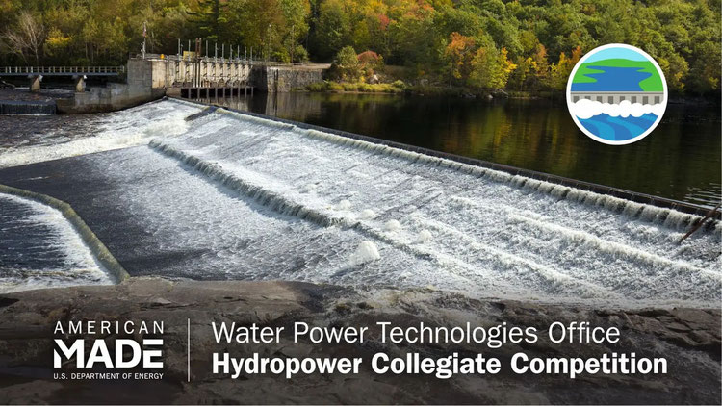
Concept Generation Continued
Goals:
Produce up to 1 GW of power total
Hold that generation for between 8 and 24 hours
Be as environmentally, economically, and safety conscious as possible
At present, we cannot make decisions without finalizing site selection
Fig. 3 - image from the HCC website [5]
F24toSP25_08
Noah Dilworth

Slide 8
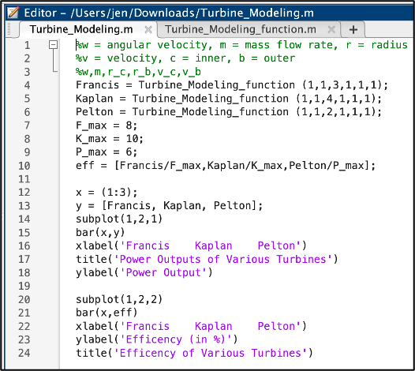
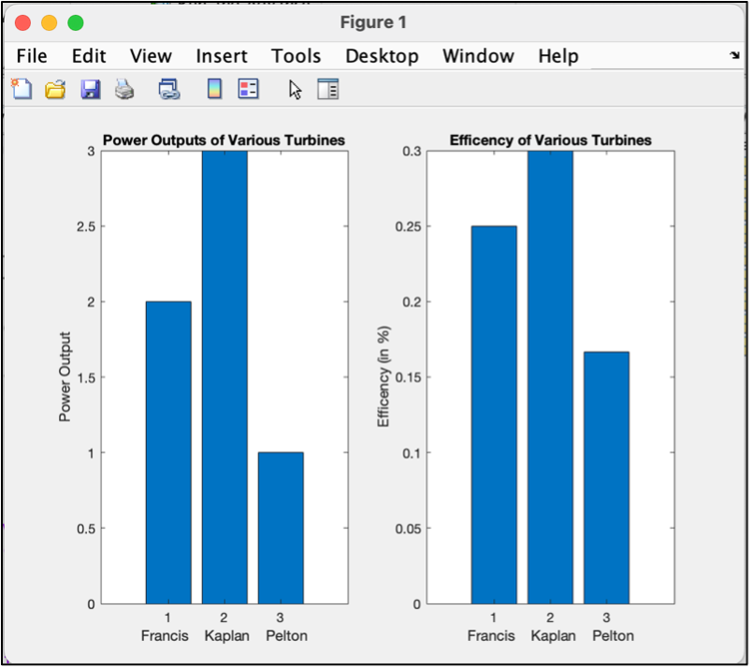
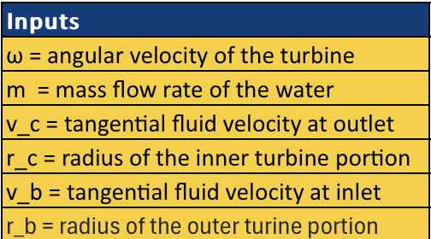
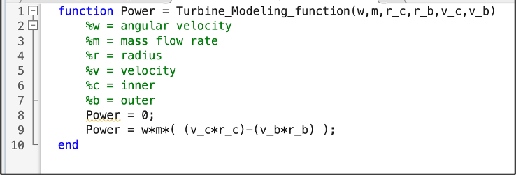
Concept Evaluation – Turbine
Euler's Turbine Equation
[1]
Figure 5: Output Results Comparing 3 Turbines.
Figure 4: MATLAB Code for Output Power of 3 Different Turbines.
Figure 3: MATLAB Function for Euler's Equation.
F24toSP25_08
Jennifer Edgar
Notes:
Our last Excel model was a rough draft; we found that because data such as inlet pressures and velocities were unavailable, we had to come up with a new equation and now we model potential energy based on the Oak Ridge Laboratory Report titled “An Assessment of Energy Potential at NPDs in the US”
More results for this example are in specification tables on next slide for Bartlett Dam

Slide 9
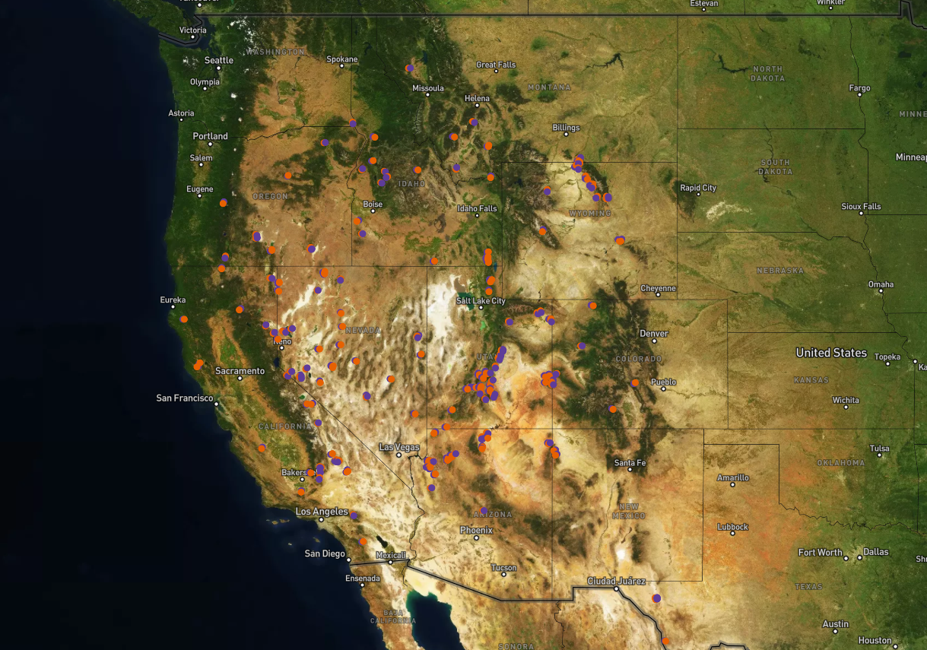
Engineering Model – ArcGIS Pro
Figure 6: Possible Closed Loop Pumped Storage Hydro Systems from NREL [4]
F24toSP25_08
Ben Tushingham

Slide 10
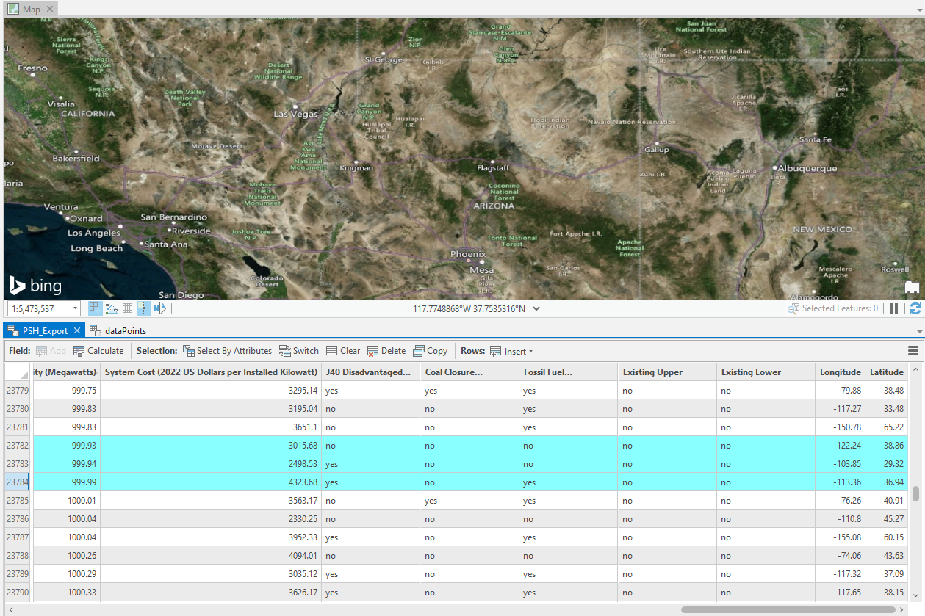
ArcGIS Pro – Continued
Figure 7: 3 Top Sites Based off Reservoir Size
F24toSP25_08
Ben Tushingham

Slide 11
Calculations – Potential Energy Generation
Energy Storage(MWH)
Energy Capacity (MW)
From Smallest Reservoir setup
Vw= 7.25 GL h = 580m
Es = 8702 MWH
Eg = 362 MW
F24toSP25_08
Ben Tushingham
Notes:
Our last Excel model was a rough draft; we found that because data such as inlet pressures and velocities were unavailable, we had to come up with a new equation and now we model potential energy based on the Oak Ridge Laboratory Report titled “An Assessment of Energy Potential at NPDs in the US”
More results for this example are in specification tables on next slide for Bartlett Dam

Slide 12
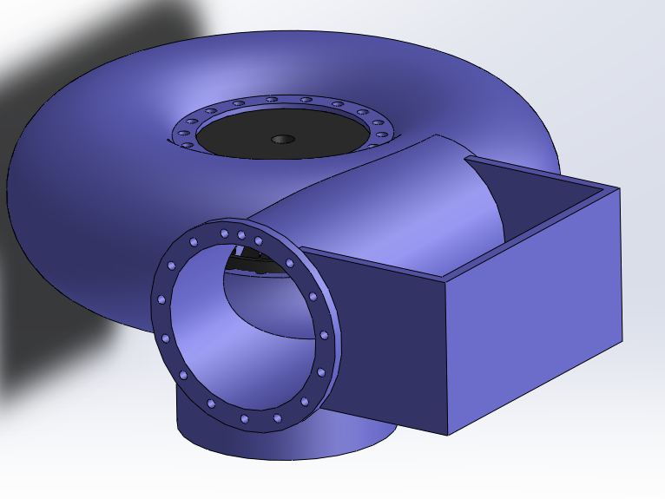
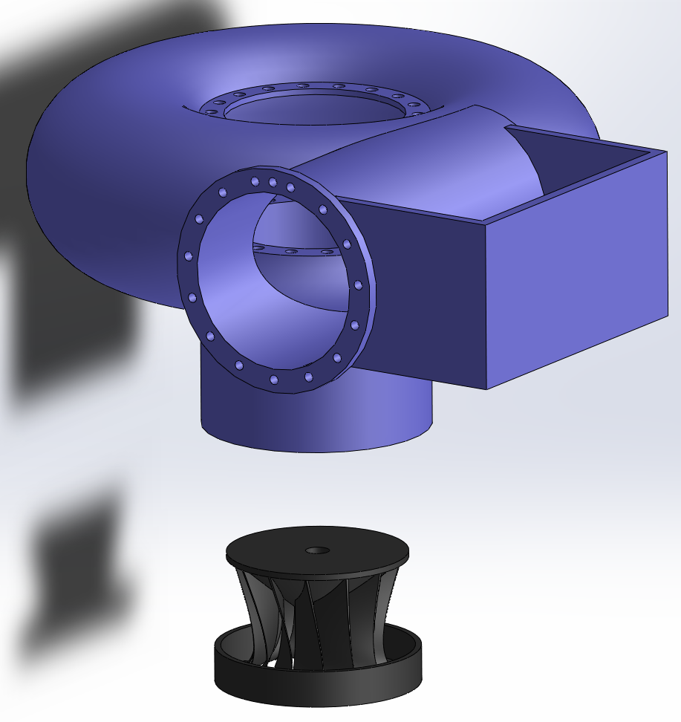
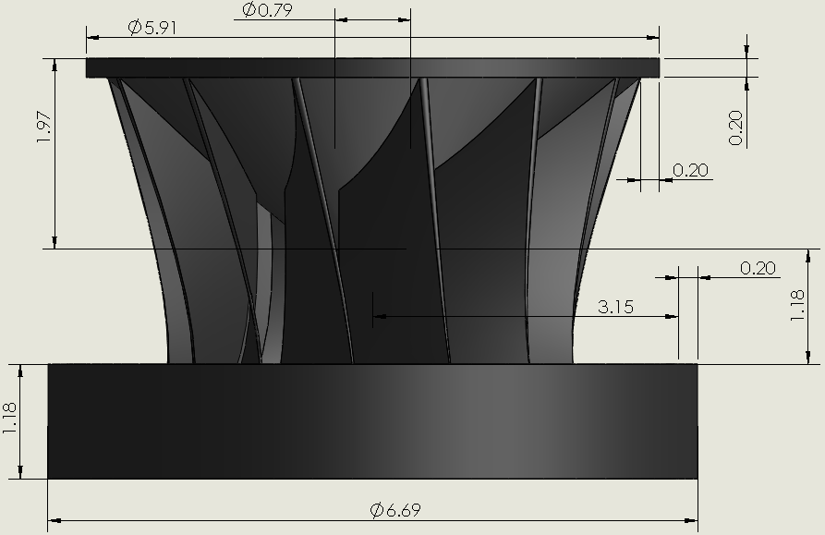
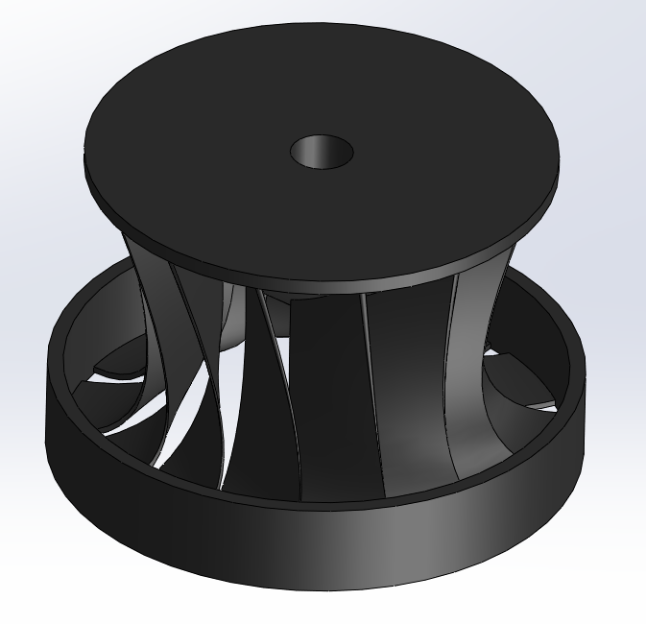
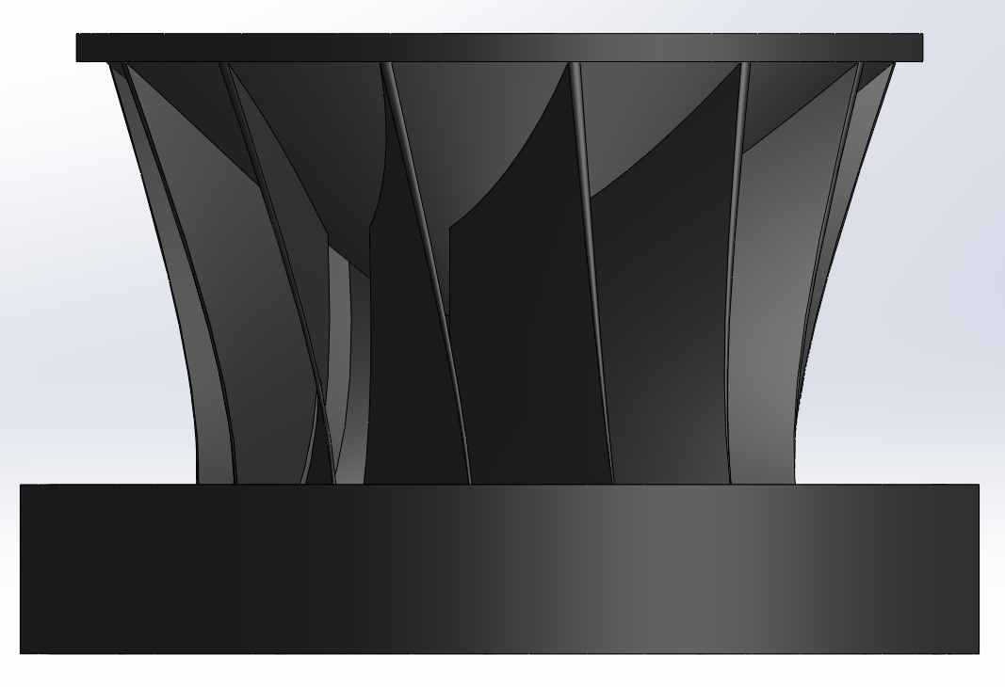
Cad Model – Francis Turbine Rough Draft
Figure 8: Turbine Dimensions (in) [3]
Figure 9: Turbine Assembly [3]
Figure 11: Isometric View Turbine [3]
Figure 12: Turbine Side View [3]
Figure 10: Exploded View [3]
F24toSP25_08
Robert Ginieczki

Slide 13
Cad Model – Closed Loop Theoretical Site
Penstock upper and lower reservoirs
Mainline from upper reservoir to turbine housing
Turbine housing
Lower reservoir
Pump housing
Return line
Support (Solar) energy
Maintenance/support housing
Figure 13: Theoretical Site Design
F24toSP25_08
Robert Ginieczki

Slide 14
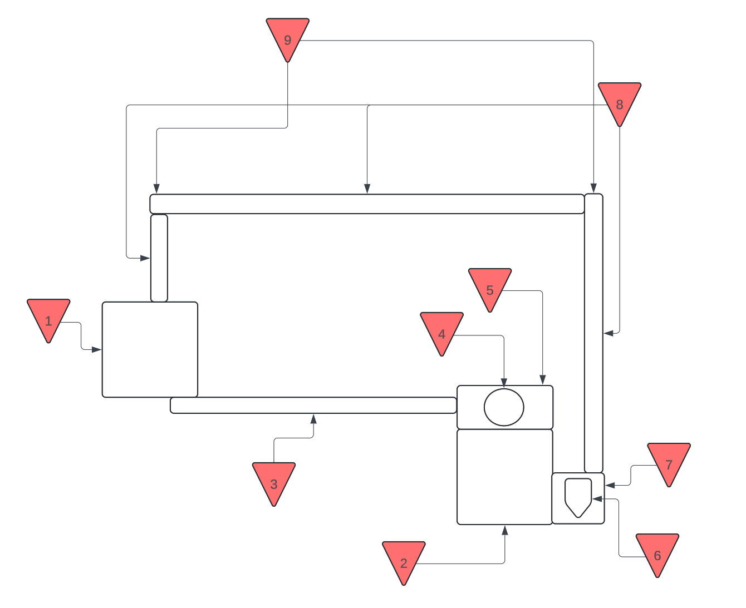
Bill Of Materials
Small Scale Closed-Loop Hydropower System Initial Design
Figure 14: Bill of Material Spreadsheet
Figure 15: Skeletonized Closed-Loop Diagram
F24toSP25_08
Robert Ginieczki

Slide 15
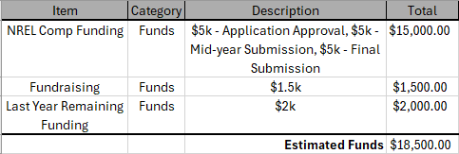
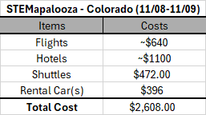
PROJECT BUDGET
SUMMARY
Estimated Funds = $18,500
Estimated Costs = $2,701.99
Available Funds = $15,798.01
Figure 16: Total Funding Availability
Figure 17: STEMapalooza Costs
Figure 18: To-Date Estimated Expenses
F24toSP25_08
Robert Ginieczki

Slide 16
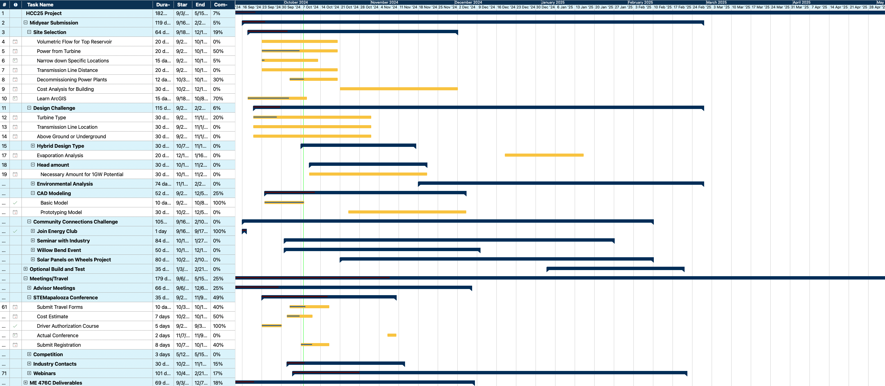
SCHEDULE
F24toSP25_08
Jennifer Edgar

Slide 17
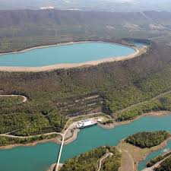
Conclusion
ArcGIS mapping efforts have given us new site criteria
Next Steps: Focus on narrowing down site selection and website development
Goals: Use concept generation and research as head start for prototyping
Small advancements in project from our HCC kickoff meeting last Friday
F24toSP25_08
Jennifer Edgar

Slide 18
References
[1] “The Euler Turbine Equation ,” 12.3 the Euler turbine equation, https://web.mit.edu/16.unified/www/FALL/thermodynamics/notes/node91.html [accessed Oct. 4, 2024].
[2] F. M. White and H. Xue, Fluid Mechanics. New York, NY: McGraw-Hill, 2021.
[3] Grabcad, "Francis Turbine," Grabcad Library, Oct. 04, 2023. [Online]. Available: https://grabcad.com/library/francis-turbine-13. [Accessed: Oct. 07, 2024].
[4] “Closed-Loop Pumped Storage Hydropower Supply Curves,” www.nrel.gov. https://www.nrel.gov/gis/psh-supply-curves.html
[5] "US Department of Energy Hydropower Collegiate Competition", Open Energy Information, Data and Resources. [Accessed Oct. 7, 2024]. Avaliable: https://openei.org/wiki/Hydropower/Prizes_and_Competitions/Hydropower_Collegiate_Competition_(HCC).
‌
F24toSP25_08

Slide 19
Thank You!

